Slide 1
SBI Ticket Office
Presented by:
Jonathan Chiang, Kawing Wong, Michael Leung, Youngseo Kweon

Slide 2
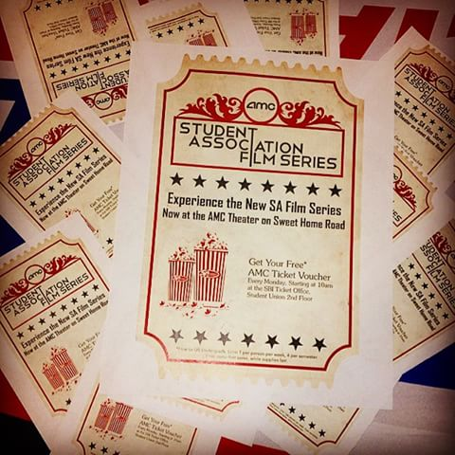
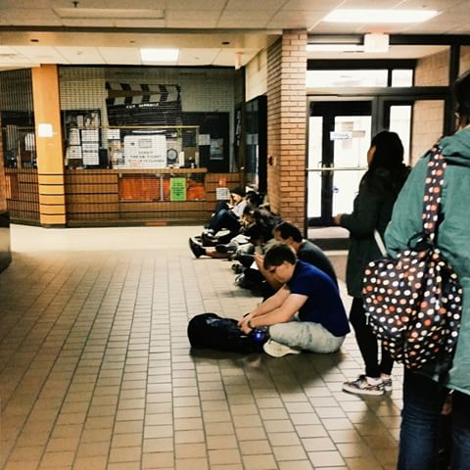
SBI Ticket Office
2nd floor of the Student Union
Provide ticket sales to events for student organization
Revenue is first collected and processed by SBI Ticket Office

Slide 3
Problems
Lack of Information for Cashiers
Event location
Beginning/ending sale date
What the event is about
The number of tickets sold
Take long time to process
Lower sales revenue
Bad impact on SBI ticket office

Slide 4
Solutions
Create a database containing all the necessary information

Slide 5
Website
http://www.Ubsbi.weebly.com

